Slide 1
Is a 50 State “Tore SAys” Grassroots Affiliate
“South Carolina
Freedom Fighters”

Slide 2
Tore Maras – A former Intelligence Contractor turned whistleblower/podcaster, has helped organize and educate “the PEOPLE” in All 50 states, to use the power of the “pen” and our State and U.S. Constitution to demand change!

Slide 3
Civil lawsuit
Filed on August 29, 2022 in United States District Court in Columbia,
South Carolina

Slide 14
WHY have
South Carolina
Elections been
FEDERALIZED?

Slide 15
Obama’s Campaign Promise

Slide 16
Valerie Jarrett, Senior Advisor to Obama said, “No election to worry about after this is over….” referring to Hillary Clinton if she had won the election in 2016.

Slide 17
DHS Secretary
Jeh Johnson
Designates Elections
CRITICAL INFRASTRUCTURE
January 6, 2017

Slide 22
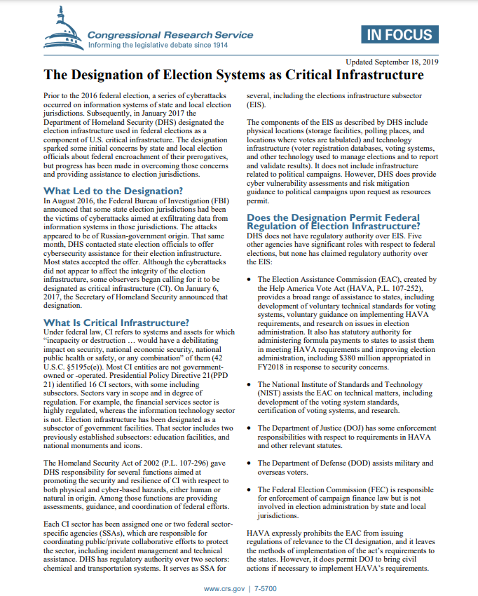

Slide 23
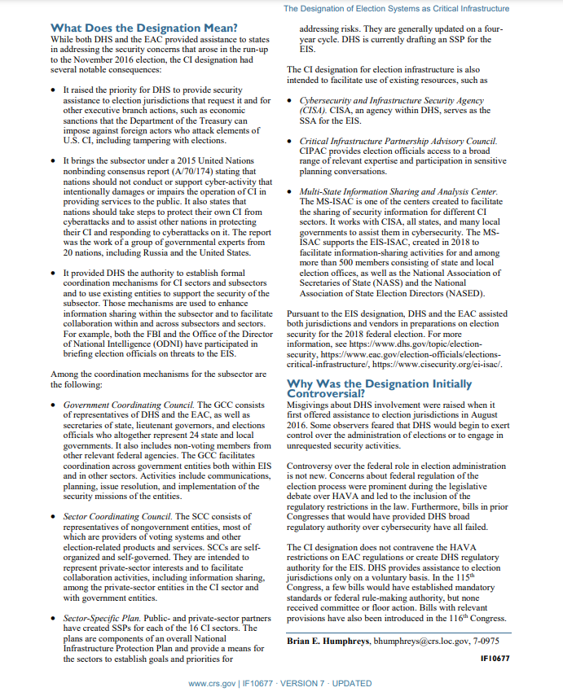

Slide 29
GEORGIA’S
2016
ELECTIONS

Slide 41
“Free Thought Project” Article
By JACK BURNS
DEC 15, 2016
All 10 Election Hacks Inside the US in Georgia Have Been Tracked to DHS -- NOT RUSSIA
Corporate Media is dead silent on the fact that DHS was just caught hacking the Georgia state election servers, not once, not twice, but ten times!

Slide 42
Late breaking developments have emerged in the case of Georgia vs. The Department of Homeland Security. As Claire Bernish of “The Free Thought Project” reported on December 9th, Georgia’s secretary of State Brian Kemp penned a letter to DHS Secretary Jeh Johnson, asking the director if he was aware that DHS had attempted to hack into the server hosting the state’s voter registration database, and if so, why was DHS doing so. Today it was revealed that not only did DHS attempt to penetrate GA’s firewall once, but it had in fact attempted to do so a total of 10 times.

Slide 43
With the official narrative coming from the Obama administration, indeed, the president himself, that the Russians stand guilty of hacking the presidential election of 2016, many are left scratching their heads in disbelief that the only government found to be hacking a state election systems, thus far, is DHS.

Slide 44
Atlanta’s WSB-TV spoke with Kemp who said, “We need to know! We’re being told something that they think haven’t figured out yet, nobody’s really shown us how this happened.” The attacks came in February (2nd, 28th), May (23rd), and November (7th, 8th), totaling 10 in all, with the two latest attacks coming on the day before and the day of the presidential election.

Slide 45
South Carolina Elections DESIGNATED CRITICAL INFRASTRUTURE!

Slide 55
CIS Partnership with
South Carolina
Board of Elections, State and County

Slide 62
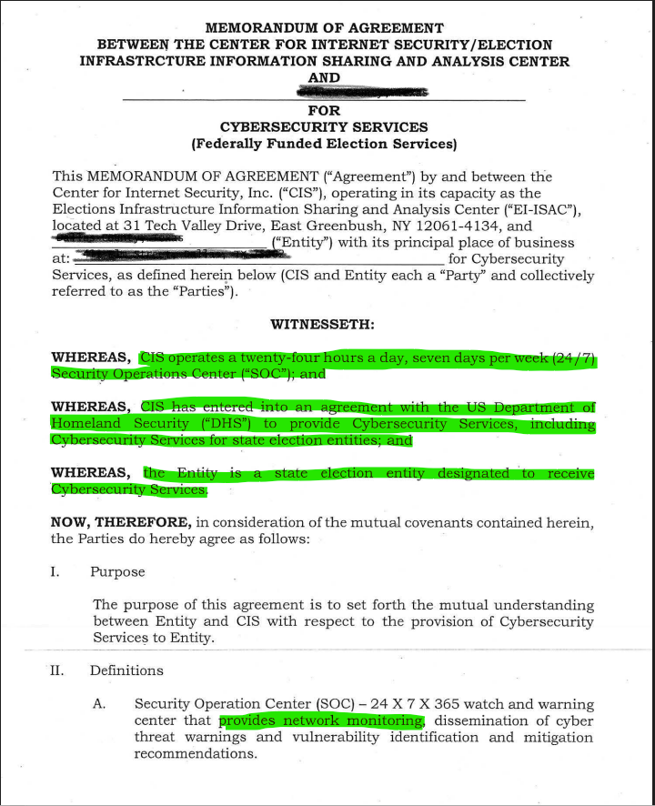

Slide 63
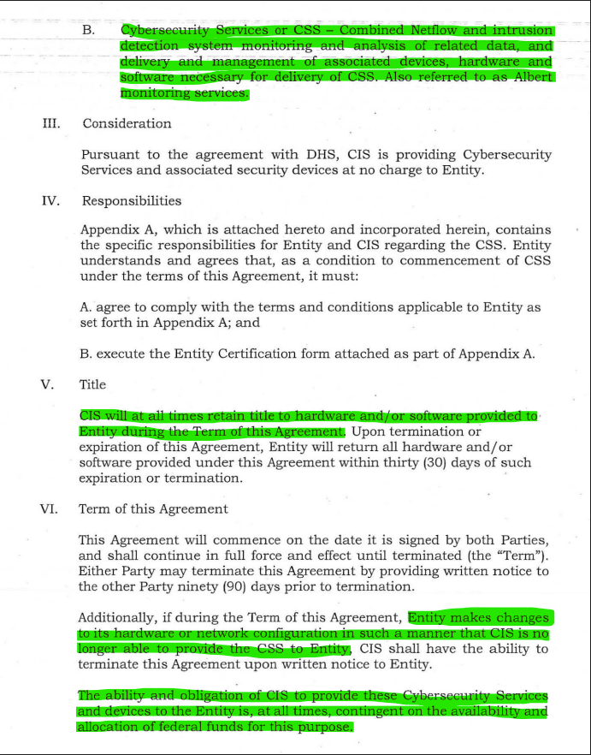

Slide 64
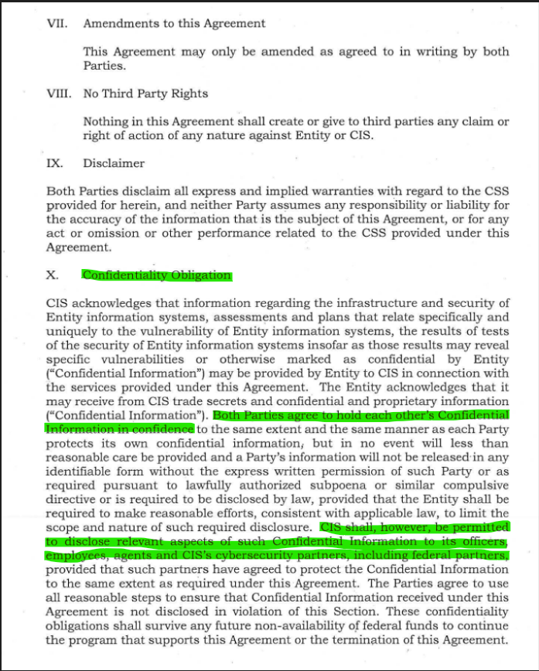

Slide 65
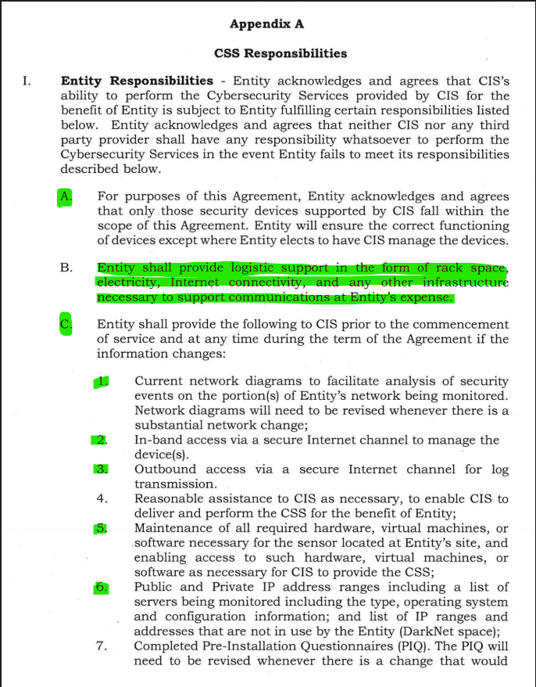

Slide 66
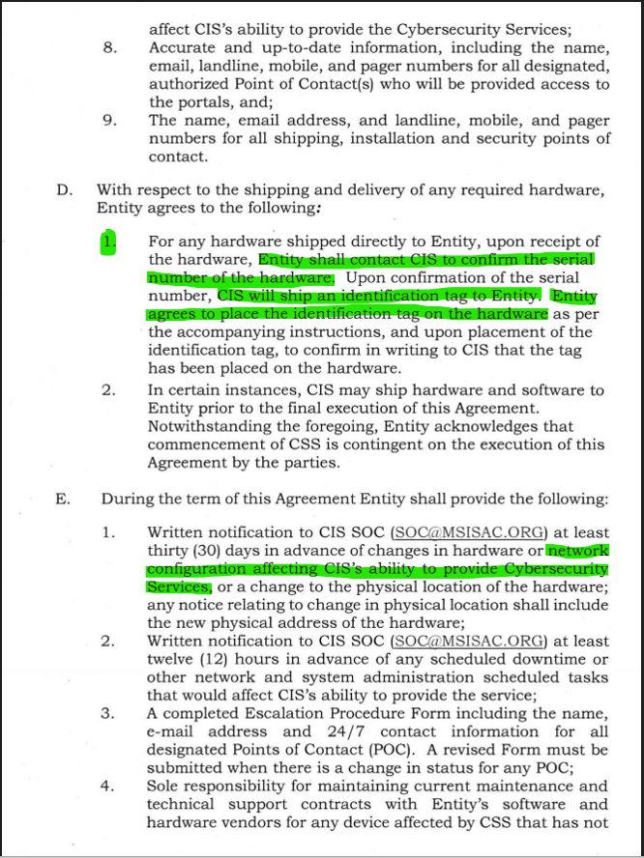

Slide 67
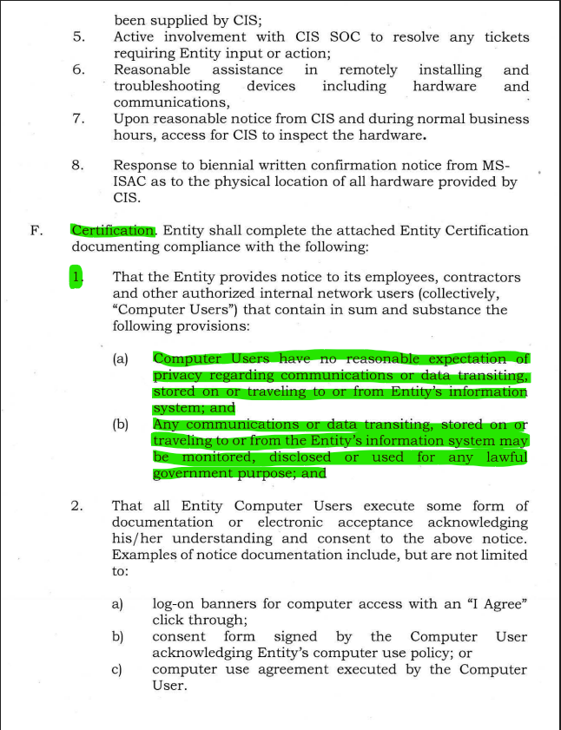

Slide 68
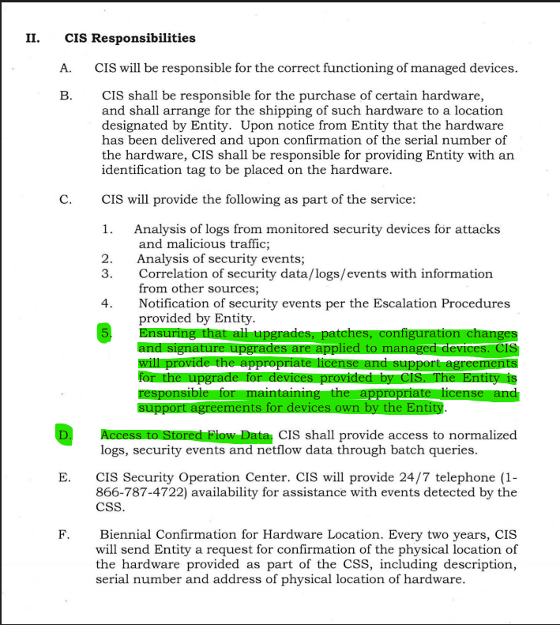

Slide 69
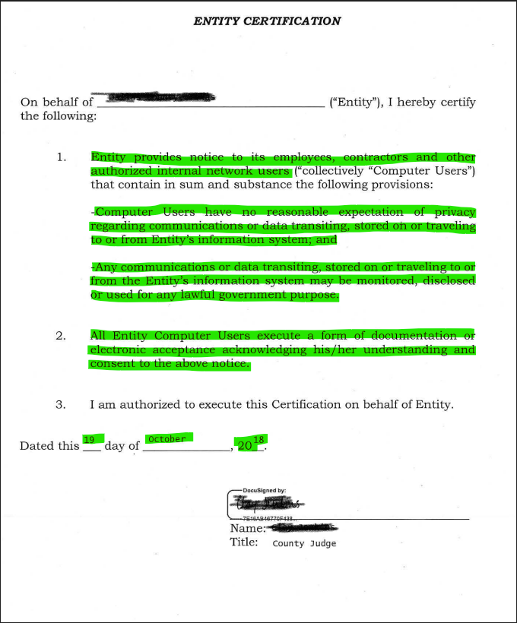

Slide 70
In 2018, CIS went to ONLINE Registration, Agreement to Terms and Conditions for Partnership

Slide 72
FOIA CISA
Email Communications regarding elections

Slide 78
According to Local News: WLTX Published: 9:57 AM EDT May 13, 2021,Executive Director of SC Election Commission resigns
COLUMBIA, S.C. — In a letter to the Chairman of the South Carolina Election Commission (SCEC), Marci Andino, Executive Director of the Commission, submitted her resignation to be effective at the end of 2021.
Andino has been the director of the agency overseeing voter registration and elections in the state for the past 18 years, as it's fourth director.
In her years at SCEC, she oversaw a new statewide voter registration system, implementation of state laws -- including Photo ID laws -- and established a "fair and transparent" filing system when legislation changed in 2013.

Slide 79
Andino writes that the long term goal set by the first executive director was to implement a uniform statewide voting system. In 2019, she oversaw a second statewide voting system that enhanced security at the polls and added paper records of every vote cast.
In her last two years as director, she saw a pandemic affect thousands as they went to the polls. "The results were extraordinary. Record numbers voted, polling places were safe, wait times were low, results were reported on time, and very few election protests were filed," she wrote.
Due to the pandemic, Andino pushed the SC Legislature to allow all voters to vote absentee, apply for absentee ballots online and allow absentee ballots to be returned via drop box. She also asked lawmakers to allow election officials more time to count the returned absentee votes.

Slide 80
Marci Andino Resigned at the end of 2021
She was given a PROMOTION as Senior Director of EI-ISAC that is funded by the Department of Homeland Security.

Slide 84
CALL TO ACTION:
FILE EMERGENCY INJUNCTIONS IN EACH COUNTY CITING THE STATE CASE CIVIL ACTION # 3:22-cv-2872-SAL-PJGTO CEASE AND DESIST THE ELECTION MACHINES

